Slide 1
Deep Learning and D (RL)
Tutorial 1: Intro to PyTorch
Tutorial 2: Practical Deep (RL)
Mariano Phielipp / Nov / 18

Slide 2
PyTorch
What’s PyTorch?
Why PyTorch?
Collaboratory from Google. Running in your Google Drive. All the code and data stays in your Google drive. (GPUs, TPUs (BERT example))
PyTorch: Part 1.
Break.
PyTorch Part 2.
Break.
Practical D(RL)

Slide 3
Content : Part 1
Tensors and Variables.
Initialize Random [ Always initialize your tensors].
Operations.
Resizing\Reshaping the Tensors.
Reproducibility and the random seed.
Matrix : Identity and others.
Initialize Tensor with a range of value.
Initialize a linear or log scale Tensor.
From numpy and to numpy.
Casting.
Variables and Gradients

Slide 4
Content : Part 2
DL Models in PyTorch.
Loss Function.
Optimizer
Training vs Evaluation.
Core Training Step.
Computing Metrics.

Slide 5
Practical D (RL)
What’s D ( RL)
Stable Baselines Library. (We are going to follow their material.)
Getting Started.
Training, Saving, Loading.
Multiprocessing.
Monitor Training and Plotting.
Atari Games.

Slide 6
What’s D (RL)
Act
Agent
Environment
Reward
State

Slide 7
Terminology
Policy ~ π(s,a)=s
Episode
Goal: Find the actions that in expectation maximize the rewards of our actions.

Slide 8
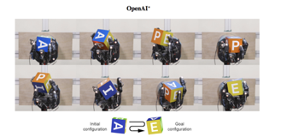
D (RL) Popular Successes
Alpha Go / Alpha Zero
DOTA (Real Time Strategy Game)
Dextrous manipulation ( Open AI )
Google Server Farm Temperature Control

Slide 9
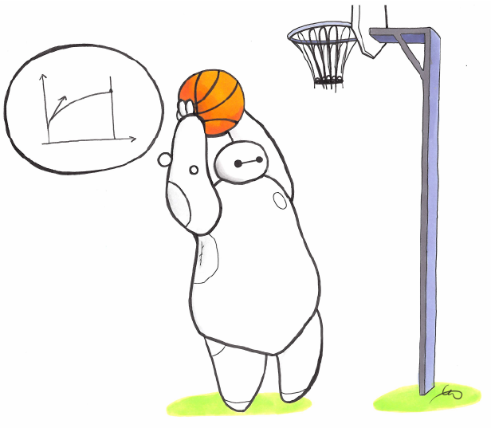
Stable Baselines
A fork from Open AI Gym: https://github.com/hill-a/stable-baselines
Getting Started.
Training, Saving, Loading.
Multiprocessing.
Monitor Training and Plotting.
Atari Games.

